Slide 1


Sponsored Programs Administration Resource & Knowledge Series
AWARD NOTIFICATION
& NEGOTIATION
Presented by:
Brion Berman, Sandra Sovinski,
Terri Vallery, Laurianne Torres

Slide 2
General Business
Last session was chock-full of information that
we will refer to today and in later sessions!
AWARD NOTIFICATION & NEGOTIATION

Slide 3
General Business
Interested in Certification?
Want to Be a Certified Research Administrator?
http://www.cra-cert.org/
Email Doshie Walker to let her know that you are interested in attending the CRA study group.
AWARD NOTIFICATION & NEGOTIATION

Slide 4
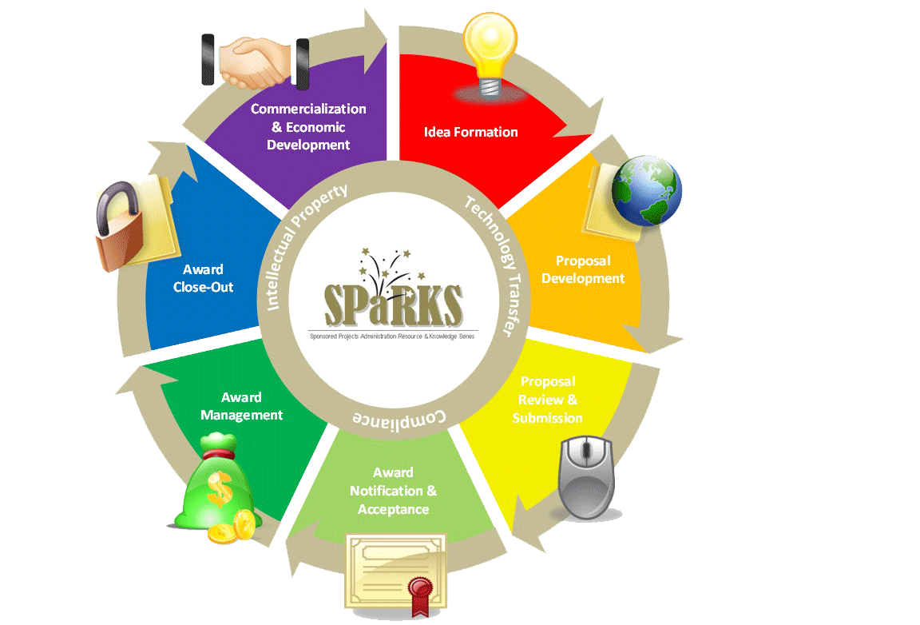
Exploring Research Administration from Concept to Commercialization

Slide 5
Exploring Research Administration from Concept to Commercialization
AWARD NOTIFICATION
Award Receipt
Is it a GIFT or a GRANT?
Awardee: UCF or UCF RF?
Funding Mechanisms
Terri Vallery & Laurianne Torres

Slide 6
AWARD NOTIFICATION
Award Receipt
Notification of Award
  How is it received?
    By mail, by email
    To ORC, to faculty member
  Who is responsible?
    ORC is authorized to bind the University contractually
AWARD NOTIFICATION & NEGOTIATION

Slide 7
AWARD NOTIFICATION
Is it a GIFT or a GRANT?
No single indicator: one vs. the other
Grants are reciprocal
  each party giving/receiving
Gifts are contributions
  with no expectation in return
Federal funds should never be treated as a gift
AWARD NOTIFICATION & NEGOTIATION

Slide 8
AWARD NOTIFICATION
Is it a GIFT or a GRANT?
CHARACTERISTIC | GIFT | GRANT
Defined Scope of Work? | NO | YES
Revocability? | NO | YES
Award Terms (Publication, IP, Royalty Sharing, etc.)? | NO | YES
Cost & Budget Information Required? | NO | YES
Detailed Reporting? | NO | YES
Performance Period / Milestones? | NO | YES
Return of Unexpended Funds? | NO | YES
Unrestricted Funds (no contract terms)? | YES | NO
Report of Accomplishments (Impact of Support) | YES | NO
No specified performance period? | YES | NO
AWARD NOTIFICATION & NEGOTIATION

Slide 9
AWARD NOTIFICATION
Awardee: UCF or UCF RF?
The UCF RF does not accept federal funding
ORC’s C&G staff handle proposal and award administration for both UCF and UCF RF projects
The UCF RF limits the receipt of state funding to <$500K per year
C&G projects funded by industry can be accepted by either UCF or the UCF RF
AWARD NOTIFICATION & NEGOTIATION

Slide 10

THINK ABOUT IT…
Benefit(s) of using the UCF RF is/are?
  a. Some agencies can only fund 501(c)(3) organizations.
  b. UCF RF can accept contractual language that UCF cannot.
  c. UCF RF can pay for items that UCF cannot, if the sponsor’s terms allow.
  d. All of the above.
AWARD NOTIFICATION & NEGOTIATION

Slide 11
AWARD NOTIFICATION
Funding Mechanisms - Federal
Grant
Contract
Cooperative Agreement
Assistance to accomplish a public purpose
Legally binding document
Award to accomplish a public purpose, but with substantial sponsor involvement in design and execution
Idea originates with the recipient
Federal procurement to acquire property or services for direct benefit or use of the Sponsor Government
Fellowship
Award generally made to an individual, not through the institution
AWARD NOTIFICATION & NEGOTIATION

Slide 12
AWARD NOTIFICATION
Funding Mechanisms - Other
Purchase Order
Used to request goods or services in return for payment
Master Task Order
Authorizes work and appropriates funds in increments/supplements
IDIQ
Delivery order requesting an indefinite delivery and indefinite quantity
Any award instrument that includes financial consideration
Subaward
Transfers a portion of a larger award to another institution
Letter Agreement
Basic agreement for goods or services with specific terms and conditions
AWARD NOTIFICATION & NEGOTIATION

Slide 13
THINK ABOUT IT…
Which of the following is true about a Cooperative Agreement?
  a. The sponsor’s staff WILL be actively involved in the proposal preparation.
  b. The sponsor’s staff will NOT be actively involved in the proposal preparation.
  c. The sponsor’s staff will be actively involved in the proposal audit.
  d. None of the above.
AWARD NOTIFICATION & NEGOTIATION

Slide 14
Exploring Research Administration from Concept to Commercialization
AWARD NEGOTIATION
Applicable Regulations
Negotiation Process
Negotiating Terms
Terri Vallery & Laurianne Torres

Slide 15

AWARD NEGOTIATION
Applicable Regulations
What regulations apply to an award depends largely on 3 things:
UCF or UCF RF policies and procedures always apply.
Who the awardee is (UCF or UCF RF)
Type of Sponsor
Type of Award (Funding Mechanism)
AWARD NOTIFICATION & NEGOTIATION

Slide 16
AWARD NEGOTIATION
Applicable Regulations
The compass that guides our decision-making:
  Federal
    OMB Circulars
      A-21 – Cost Principles for Educational Institutions (UCF)
      A-122 – Cost Principles for Nonprofit Organizations (RF)
      A-110 – Administrative Requirements
      A-133 – Audit
    Federal Acquisition Regulations
AWARD NOTIFICATION & NEGOTIATION

Slide 17
AWARD NEGOTIATION
Applicable Regulations
The compass that guides our decision-making:
  State
    Florida Statutes
    Florida Administrative Code
  Internal
    UCF Policies & Procedures
    RF Guidelines and Business Manual
  Sponsor-specific terms & conditions
AWARD NOTIFICATION & NEGOTIATION

Slide 18
THINK ABOUT IT…
True or False?
The Federal Acquisition Regulations (FAR) apply to all types of federal funding mechanisms
(contracts, grants, cooperative agreements).
AWARD NOTIFICATION & NEGOTIATION

Slide 19
AWARD NEGOTIATION
Applicable Regulations
 | Federal Grant | Federal Contract | Federal Cooperative Agreement | Federal Flow-Thru | State Grant or Contract | Private/NonProfit/Industry Grant or Contract
Florida Statutes | X | X | X | X | X | X
Florida Administrative Code | X | X | X | X | X | X
UCF Policies & Procedures | X | X | X | X | X | X
UCF RF Policies & Procedures |  |  |  |  | X (if award is run through UCF RF) | X (if award is run through UCF RF)
Federal Acquisition Regulations |  | X |  | X (if prime is a Federal Contract)
OMB Circulars | X | X | X | X | X | X
Sponsor-specific Terms & Conditions | X | X | X | X | X | X
AWARD NOTIFICATION & NEGOTIATION

Slide 20
AWARD NEGOTIATION
Negotiation Process
Not all award types require negotiation!
Who is responsible for negotiation?
What is involved in the process?
AWARD NOTIFICATION & NEGOTIATION

Slide 21
THINK ABOUT IT…
True or False?
If UCF is able to successfully negotiate out a troublesome clause that would restrict the faculty member’s ability to publish, it means that the project work is not subject to Export Control laws.
AWARD NOTIFICATION & NEGOTIATION

Slide 22
AWARD NEGOTIATION
Negotiating Terms
Goal is to protect the University and the PI’s interests
Troublesome clauses
Negotiable vs. Deal-breakers
Each award is unique
AWARD NOTIFICATION & NEGOTIATION

Slide 23
THINK ABOUT IT…
True or False?
The UCF RF has sovereign immunity.
AWARD NOTIFICATION & NEGOTIATION

Slide 24
AWARD NEGOTIATION
Negotiating Terms
Indemnification
Governing Law
Publication
Deliverables
Administrative Issues
Equipment Vesting
Revenue Collection
Liability/Risk Assessment
Warranties
IP and Data Rights
TERMS TO CONSIDER
AWARD NOTIFICATION & NEGOTIATION

Slide 25
Exploring Research Administration from Concept to Commercialization
INTELLECTUAL PROPERTY OVERVIEW
Forms of Intellectual Property
Patents: Types of Patents & Patent Protection
Trademarks & Service Marks
Copyrights
Trade Secrets
Protecting Your IP from Within
Sandra Sovinski

Slide 26

INTELLECTUAL PROPERTY OVERVIEW
Four Forms of Intellectual Property
Patents
Trademarks
Copyrights
Trade Secrets
AWARD NOTIFICATION & NEGOTIATION

Slide 27



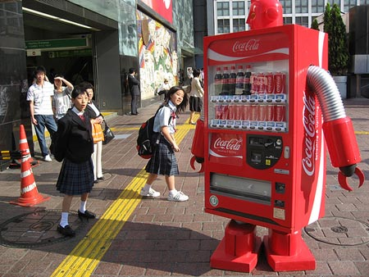





INTELLECTUAL PROPERTY OVERVIEW
Coca-Cola ®
An Example of Effective IP Usage
Bottle Shape
The word: COKE
Logo
TV Commercial
Machine Look
The Formula
Print Ads
Bottling System
Packaging
Can’s Artwork
AWARD NOTIFICATION & NEGOTIATION

Slide 28

INTELLECTUAL PROPERTY OVERVIEW
Types of Patents
UTILITY 20 Year Term
New, Useful & Non-Obvious Process, Machine, Manufactured Good, Composition of Material, or Improvement Thereof
DESIGN 14 Year Term
PLANT 20 Year Term
New Original Ornamental Design for a Product
New Variety of Asexually Reproduced Plant
AWARD NOTIFICATION & NEGOTIATION

Slide 29
THINK ABOUT IT…
True or False?
A Patent is a grant from the Federal Government of the right to EXCLUDE others from making, using or selling an invention for the term of the patent.
AWARD NOTIFICATION & NEGOTIATION

Slide 30


INTELLECTUAL PROPERTY OVERVIEW
Patent Protection
U.S. patent protection is unavailable if…
Another Party Invented/Filed First
Published >1 Year Prior
Offered For Sale > 1 Year Prior
Public Use > 1 Year Prior
Not Useful/”Ready” for Practice
AWARD NOTIFICATION & NEGOTIATION

Slide 31
INTELLECTUAL PROPERTY OVERVIEW
Patent Protection
NO grace period in MOST foreign countries.
Without an agreement to the contrary,
each Co-Inventor may license or use the patent without any duty of accounting of the proceeds
AWARD NOTIFICATION & NEGOTIATION

Slide 32
INTELLECTUAL PROPERTY OVERVIEW
Coca-Cola ® - Which are Patents?
Bottle Shape
The word: COKE
Logo
TV Commercial
Machine Look
The Formula
Print Ads
Bottling System
Packaging
Can’s Artwork
AWARD NOTIFICATION & NEGOTIATION

Slide 33
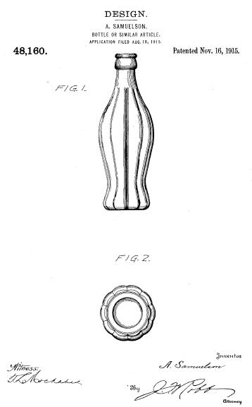
Coke Bottle Design Patent - 1915

Slide 34
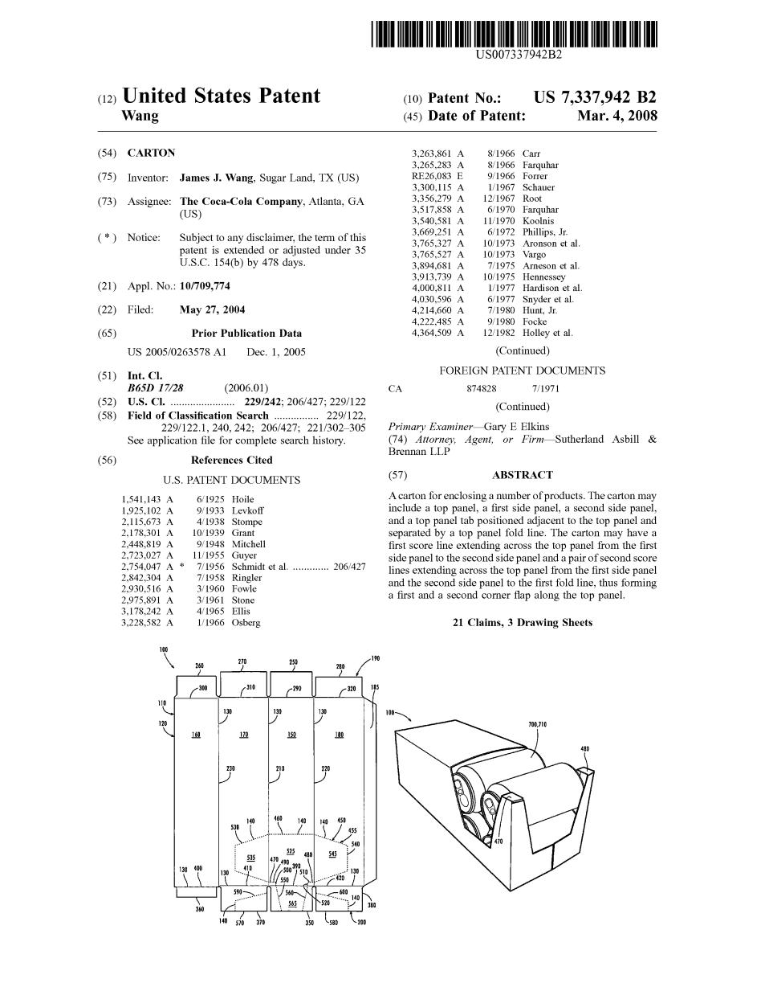
Coke package utility patent - 2008

Slide 35
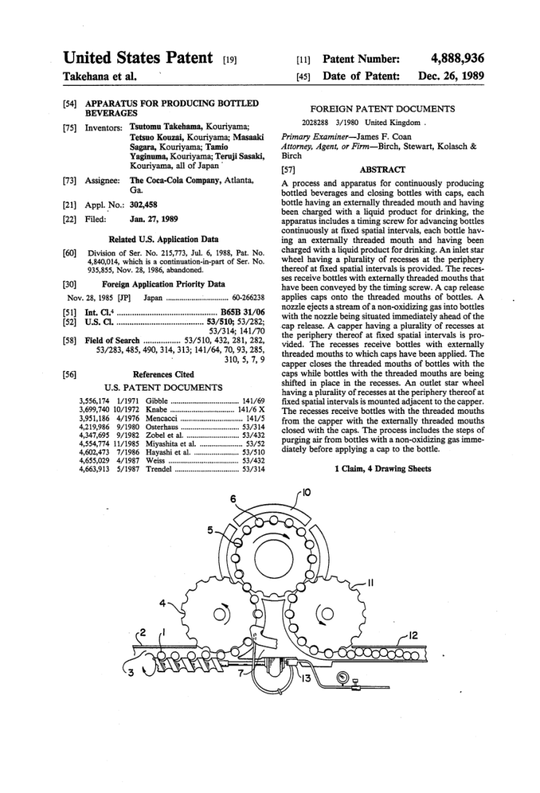
Coke manufacturing device patent - 1989

Slide 36
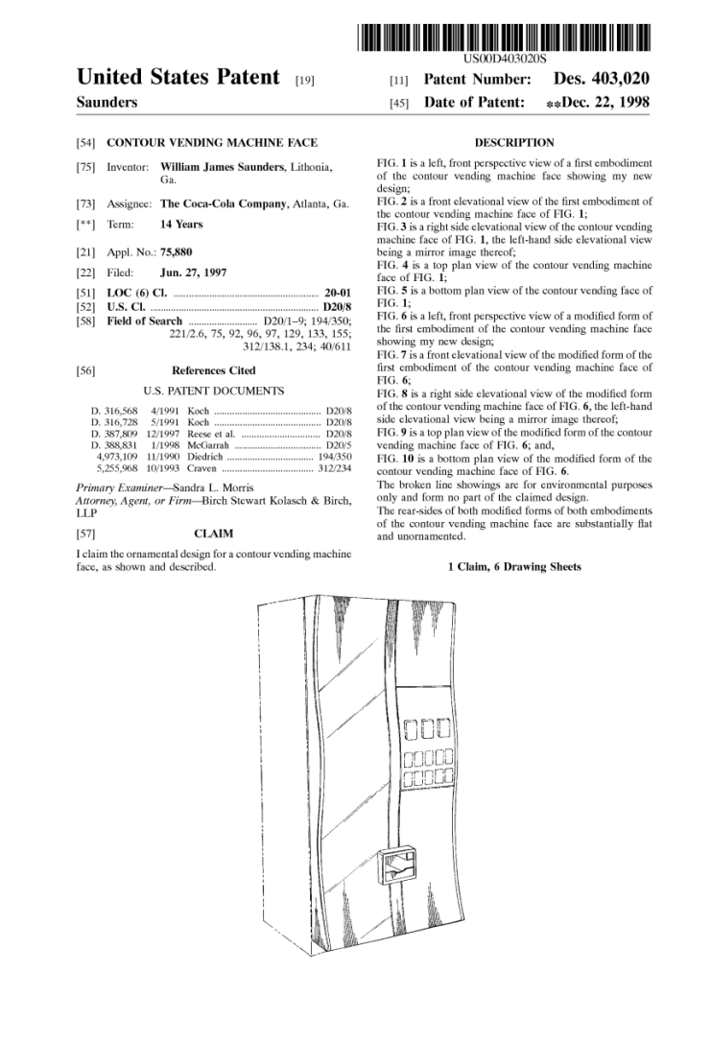
Coke vending machine design patent - 1998

Slide 37



INTELLECTUAL PROPERTY OVERVIEW
Trademarks & Service Marks
IDENTIFY the SOURCE of goods/services
Continue for life of business, are transferrable
Prevent others from using similar mark
Trademarks for goods /
Service marks for services
Trademark
Nike ®
Service Mark
FedEx®
Can be a word, device, symbol, color, sound, or combination
Trademarks for packaging / Service marks for advertising
® is ONLY for a
registered mark
Brand names, packaging, unique color schemes, slogans
TM
non-registered rights (state law)
Renewable every 10 years
Others can make/sell same goods/ services under different mark
Can last forever
AWARD NOTIFICATION & NEGOTIATION

Slide 38

INTELLECTUAL PROPERTY OVERVIEW
Trademarks
Illustration of the Multifaceted Nature of Trademark Protection
Name is a trademark
Symbol/Logo is a trademark
Slogan is a trademark
AWARD NOTIFICATION & NEGOTIATION

Slide 39
INTELLECTUAL PROPERTY OVERVIEW
Coca-Cola ® - Which Involve Trademarks?
Bottle Shape
The word: COKE
Logo
TV Commercial
Machine Look
The Formula
Print Ads
Bottling System
Packaging
Can’s Artwork
AWARD NOTIFICATION & NEGOTIATION

Slide 40
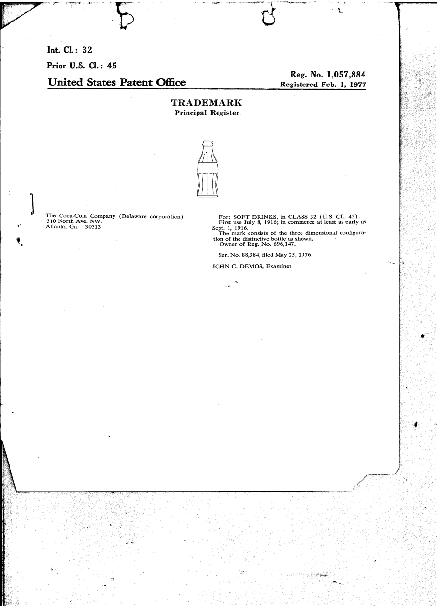
Coke bottle trade dress registration - 1977

Slide 41
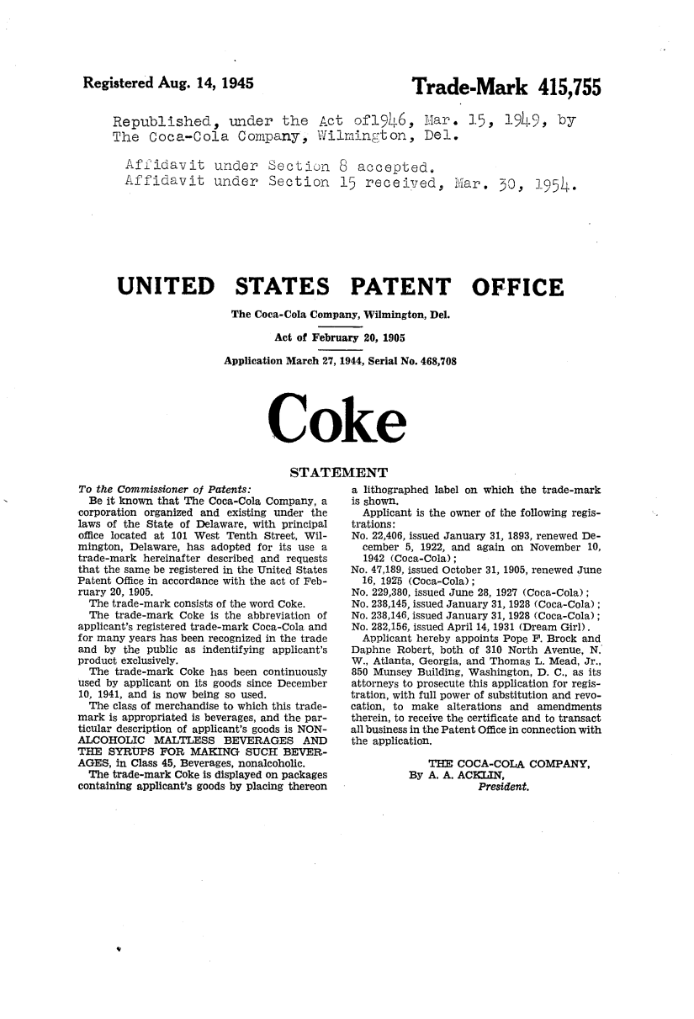
Coke word mark registration - 1945

Slide 42
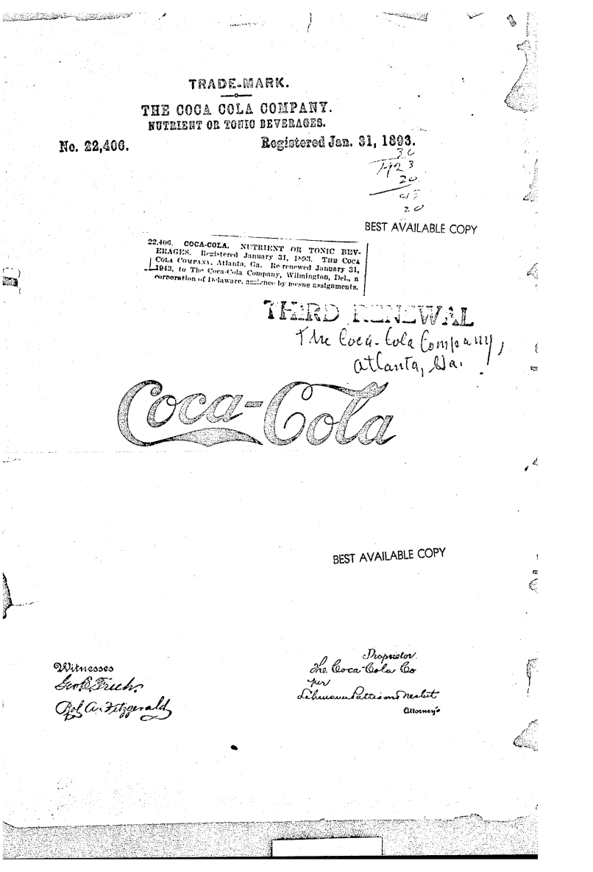
Coca cola stylized mark registration - 1803

Slide 43
INTELLECTUAL PROPERTY OVERVIEW
Copyrights
Copyright protection is automatic upon creation on an original work
Protect property of creator against unauthorized copying/derivative use
Good for the life of the author + additional 70 years
Whether registered or not, include notice:
© or the word “copyright”
First year of publication
Name of owner or institution
Example: © 2011 John Doe. All rights reserved.
Literary, musical, software, dramatic, choreographic, pictorial, graphic, sculptural, audiovisual, architectural works all covered
Allow limited “Fair Use” of materials by others for criticism, comment, news reporting, teaching, scholarship and research
Why register? $ damages, attorney fees, stronger position (lower burden of proof)
AWARD NOTIFICATION & NEGOTIATION

Slide 44
THINK ABOUT IT…
True or False?
Without an agreement to the contrary,
each Co-Author of a Copyrighted Material
may license or use the Copyright Material
but WITH a duty of accounting and sharing the proceeds.
AWARD NOTIFICATION & NEGOTIATION

Slide 45
INTELLECTUAL PROPERTY OVERVIEW
Copyright Protection
Bottle Shape
The word: COKE
Logo
TV Commercial
Machine Look
The Formula
Print Ads
Bottling System
Packaging
Can’s Artwork
AWARD NOTIFICATION & NEGOTIATION

Slide 46


INTELLECTUAL PROPERTY OVERVIEW
Trade Secrets
Provides the owner with a competitive advantage in the marketplace
Must NOT be easily duplicated, reverse engineered, or discovered
Not known outside of the institution
Trade secrets can include pattern, marketing plans, physical device, idea, product formulas, financial forecasts, employee rosters, logs of sales calls, laboratory notebooks, and similar types of proprietary information
Only shared inside the institution on “need to know” basis
Safeguarded by stringent efforts to keep it confidential
Valuable and provides institution with key competitive advantage
Was developed at great time, cost and effort
AWARD NOTIFICATION & NEGOTIATION

Slide 47
INTELLECTUAL PROPERTY OVERVIEW
Trade Secret Protection
Bottle Shape
The word: COKE
Logo
TV Commercial
Machine Look
The Formula
Print Ads
Bottling System
Packaging
Can’s Artwork
AWARD NOTIFICATION & NEGOTIATION

Slide 48
INTELLECTUAL PROPERTY OVERVIEW
Protecting Your IP from Within
“Employee” agreements
NDA to not share confidential info
Non-compete agreement to not solicit other employees to leave
Assign rights of all work, inventions, etc. to institution
Limit Access to Proprietary Information
Identify and label all confidential information
Secure information and have clear employee policy
Have visitors sign-in and escorted in confidential areas
Limit information to public – approve all publications, website content, presentation materials, etc.
Provide Notice
of Rights:
©
Patent Pending
TM
®
AWARD NOTIFICATION & NEGOTIATION

Slide 49
Exploring Research Administration from Concept to Commercialization
IMPORTANCE OF & NEGOTIATING IP
Origins of IP Law & How UCF Acquires Rights
Why do we want to protect IP?
When to Look Out for IP
Negotiating IP
Brion Berman

Slide 50
IMPORTANCE OF & NEGOTIATING IP
Origins of IP Law
Article 1, Section 8 of the Constitution states:
  "Congress shall have the power to...promote the progress of science and useful arts, by securing for limited times to authors and inventors the exclusive right to their respective writings and discoveries." (US Const., art I. sec. 8, cl. 8.)
The Bayh-Dole Act
  allows universities, small businesses and non-profits to own IP resulting from federal funding. (35 U.S.C. § 200-212)
Data Rights
  FAR 27.401 and 52.227-14
AWARD NOTIFICATION & NEGOTIATION

Slide 51
IMPORTANCE OF & NEGOTIATING IP
How UCF Acquires Rights
Florida Statute 1004.23
  Authorizes FL universities to Secure, License, Enforce IP
UCF Regulations
  UCF Regulations Faculty and Graduate Handbooks and Collective Bargaining Agreement—requires University Personnel to disclose inventions and assign rights to UCF.
  UCF-2.029 Patents, Trademarks and Trade Secrets
  UCF-2.033 Copyright and Works
AWARD NOTIFICATION & NEGOTIATION

Slide 52
IMPORTANCE OF & NEGOTIATING IP
Why do we want to protect IP?
Social, Cultural, and Economic Development
Drives industrial growth
Protects key technology
Creates a barrier to others
Generates value
Incentivizes commercialization
Helps raise living standards
AWARD NOTIFICATION & NEGOTIATION

Slide 53
IMPORTANCE OF & NEGOTIATING IP
Why do we want to protect IP?
$444M for Microsoft in 2012 for Android devices
$550M for Microsoft for patents sold to Facebook
$1.06B for AOL for patents to Microsoft
$673M for Ericsson in patent revenue in 2010
Expiring in 2011 | Condition | Company | 2010 U.S. Sales
Lipitor | cholesterol | Pfizer | $5,329,000,000
Zyprexa | antipsychotic | Eli Lily | $2,496,000,000
Levaquin | antibiotics | Johnson & Johnson | $1,312,000,000
Concerta | ADHD/ADD | Johnson & Johnson | $929,000,000
Protonix | antacid | Pfizer | $690,000,000
Expiring in 2012 | Condition | Company | 2010 U.S. Sales
Plavix | anti-platelet | Bristol-Myers Squibb/ Sanofi-Aventis | $6,154,000,000
Seroquel | antipsychotic | AstraZeneca | $3,747,000,000
Singulair | asthma | Merck | $3,224,000,000
AWARD NOTIFICATION & NEGOTIATION

Slide 54
IMPORTANCE OF & NEGOTIATING IP
Why do we want to protect IP?
Cumulative net income (gross royalties minus direct costs of patenting, licensing, legal and other related expenses) resulting from inventions is distributed as follows:
UCF Royalty Distribution
RECIPIENT | $1-$100K | $101K-$199K | >$200K
Inventors | 50% | 40% | 30%
Inventors’ College | 20% | 24% | 28%
Inventors’ Department | 20% | 24% | 28%
UCF Research Foundation | 10% | 12% | 14%
AWARD NOTIFICATION & NEGOTIATION

Slide 55
THINK ABOUT IT…
When is the best time to ask the PI if IP has been developed?
  a. At the time of project close-out.
  b. Prior to proposal submission.
  c. Upon completion of the research project.
  d. Before submitting results of the research for publication or to the Sponsor
  e. All of the above.
AWARD NOTIFICATION & NEGOTIATION

Slide 56
IMPORTANCE OF & NEGOTIATING IP
When to Look Out for IP
IP can be generated at any time:
Proposals
Contracts and Grants
Presentations
Manuscripts, Thesis, Dissertations
Collaborations
Sponsored Research
AWARD NOTIFICATION & NEGOTIATION

Slide 57
IMPORTANCE OF & NEGOTIATING IP
Negotiating IP: A Starting Point
Background Intellectual Property
All inventions, improvements and/or discoveries…which were in existence, prior to the execution date of the Agreement.
UCF Default Position on Background Intellectual Property:
  Existing Background Intellectual Property of any party existing prior to the Agreement is separate property and not affected.
  Neither party acquires rights in any Background Intellectual Property of the other that exists prior to the execution date of the Agreement.
AWARD NOTIFICATION & NEGOTIATION

Slide 58
IMPORTANCE OF & NEGOTIATING IP
Negotiating IP: A Starting Point
Mutual (Neutral) IP Language
UCF shall own all IP developed solely by UCF Personnel.
Company shall own all IP developed solely by Company’s employees.
IP jointly developed by UCF and Company
shall be jointly owned by UCF and Company
AWARD NOTIFICATION & NEGOTIATION

Slide 59
THINK ABOUT IT…
Is it always appropriate to use the mutual IP language?
AWARD NOTIFICATION & NEGOTIATION

Slide 60
IMPORTANCE OF & NEGOTIATING IP
Negotiating IP: A Starting Point
Maybe YES:
  Both UCF and Company are equally contributing
  Language does not hurt UCF’s position
  Good, ongoing relationship with Company
  Delays negotiations until later
Maybe NO:
  UCF or the Company may want more…
AWARD NOTIFICATION & NEGOTIATION

Slide 61
IMPORTANCE OF & NEGOTIATING IP
Negotiating IP: UCF May Want More
What about when:
  Contracts (UCF Prime)
  Sponsored Research is conducted at UCF
  UCF has all the expertise
  UCF provides unique materials
In these cases, more than likely, UCF wants to own more.
Limited rights for Subcontractor to use Background IP
  Possibly for a specific purpose
Flow back rights of New IP to UCF
  UCF’s ability to use New IP
  UCF owns, solely or jointly, new IP
AWARD NOTIFICATION & NEGOTIATION

Slide 62
IMPORTANCE OF & NEGOTIATING IP
Negotiating IP: What Companies Want
Companies want:
  Assignment of IP Rights
  Exclusive rights to Background IP
  Exclusive rights to New IP
    Right of First Refusal to New IP
    Upfront License terms for New IP
  UCF may be willing to consider alternatives:
License Background IP separately
Option for New IP
Non-binding upfront license terms
AWARD NOTIFICATION & NEGOTIATION

Slide 63
THINK ABOUT IT…
True or False?
In a legal agreement,
when granting to a Company a future right to UCF’s IP,
the grant of a right of first refusal to license the IP
is identical to the grant of a first option to license the IP.
AWARD NOTIFICATION & NEGOTIATION

Slide 64
IMPORTANCE OF & NEGOTIATING IP
Negotiating IP: Alternatives
But what about when:
  Contracts (UCF Sub)
  Collaborations
  UCF does not have all the expertise
  UCF receives unique materials
  In these cases, UCF usually wants to own more, but cannot negotiate for more
  UCF needs to consider:
Right for UCF to use Background IP of Contractor
Right for UCF to own IP created under subcontract
Reservation of right for continued research after the contract
AWARD NOTIFICATION & NEGOTIATION

Slide 65
IMPORTANCE OF & NEGOTIATING IP
Impacts of Negotiating IP
Regardless, you always have to consider the current and future impact of IP terms to UCF and the PI:
Future research
Funding
Collaborations
Publications
Graduate Students
Tenure
AWARD NOTIFICATION & NEGOTIATION

Slide 66

QUESTIONS or COMMENTS?

Slide 67
THANKS FOR JOINING US!
Please come to the next session:
AWARD MANAGEMENT (PART I)
July 25, 2012
10:00 am to 12:00 pm
Sponsored Programs Administration Resource & Knowledge Series

